Slide 1
Cryptography & Cyber security ( RLMCA305) – Module 2
Bismi K. Charleys, Asst.professor in MCA,LMCST

Slide 2
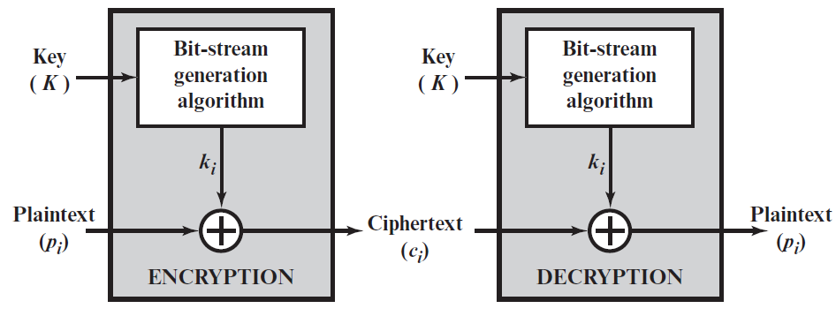
stream cipher
A stream cipher is one that encrypts a digital data stream one bit or one byte at a time.

Slide 3
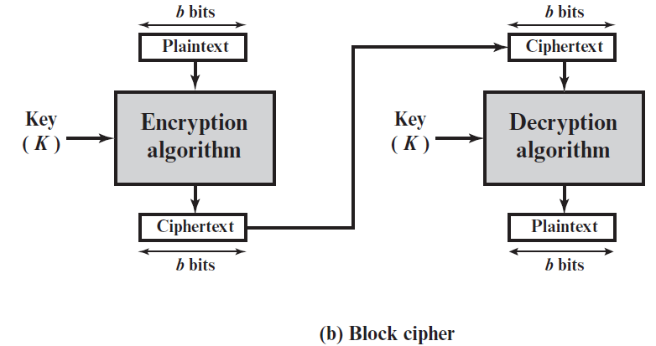
Block cipher
A block cipher is one in which a block of plaintext is treated as a whole and used to produce a ciphertext block of equal length. Typically, a block size of 64 or 128 bits is used

Slide 4
Block Cipher Design Principles
Block ciphers are built in the Feistel cipher structure. Block cipher has a specific number of rounds and keys for generating ciphertext. For defining the complexity level of an algorithm few design principles are to be considered.
They are:
Number of Rounds – The number of Rounds is regularly considered in design criteria, it just reflects the number of rounds to be suitable for an algorithm to make it more complex..
Design of Round function F – The core part of the Feistel Block cipher structure is the Round Function. The complexity of cryptanalysis can be derived from the Round function i.e. the increasing level of complexity for the round function would be greatly contributing to an increase in complexity. To increase the complexity of the round function, the avalanche effect is also included in the round function, as the change of a single bit in plain text would produce a mischievous output due to the presence of avalanche effect.
Subkeys count. In Feistel Block cipher structure, each round would generate a sub-key for increasing the complexity of cryptanalysis. The Avalanche effect makes it more complex in deriving sub-key. Decryption must be done very carefully to get the actual output as the avalanche effect is present in it.
Key size
Block size

Slide 5
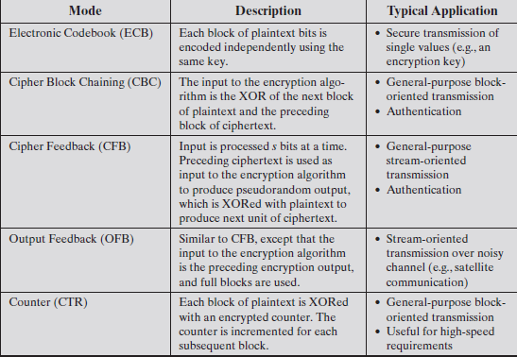
Block Cipher Modes of Operation

Slide 6
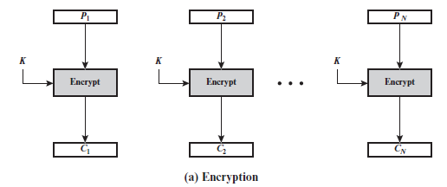
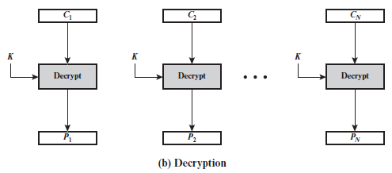
ECB
The simplest mode is the electronic codebook (ECB) mode, in which plaintext is handled one block at a time and each block of plaintext is encrypted using the same key . The term codebook is used because, for a given key, there is a unique ciphertext for every b-bit block of plaintext.

Slide 7
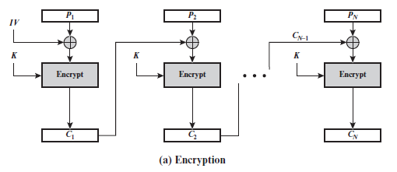
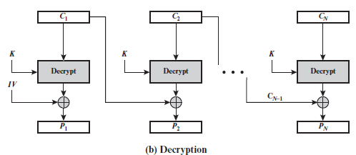
Cipher Block Chaining Mode(CBC)
To overcome the security deficiencies of ECB, we would like a technique in which the same plaintext block, if repeated, produces different ciphertext blocks. A simple way to satisfy this requirement is the cipher block chaining (CBC) mode. In this scheme, the input to the encryption algorithm is the XOR of the current plaintext block and the preceding ciphertext block; the same key is used for each block.

Slide 8
Cipher Feedback Mode
The input to the encryption function is a b-bit shift register that is initially set to some initialization vector (IV). The leftmost (most significant) s bits of the output of the encryption function are XORed with the first segment of plaintext P1 to produce the first unit of ciphertext C1, which is then transmitted. In addition, the contents of the shift register are shifted left by s bits, and C1 is placed in the rightmost (least significant) s bits of the shift register. This process continues until all plaintext units have been encrypted.
C1 = P1 ⊕MSBs[E(K, IV)]

Slide 9
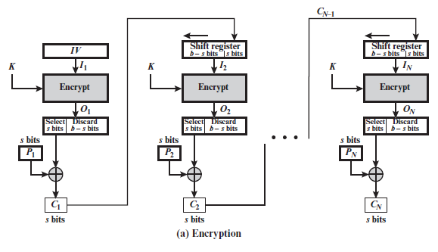
Cipher Feedback Mode

Slide 10
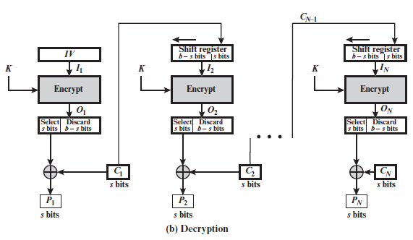
Cipher Feedback Mode
P1 = C1 ⊕MSBs[E(K, IV)]

Slide 11
Output Feedback Mode
The output feedback (OFB) mode is similar in structure to that of CFB. For OFB, the output of the encryption function is fed back to become the input for encrypting the next block of plaintext . In CFB, the output of the XOR unit is fedback to become input for encrypting the next block. The other difference is that the OFB mode operates on full blocks of plaintext and ciphertext, whereas CFB operates on an s-bit subset. OFB encryption can be expressed as
Cj = Pj⊕E(K, Oj-1)
Where
Oj-1 = E(K, Oj-2)
Cj = Pj⊕E(K, [Cj-1 ⊕Pj-1])

Slide 12
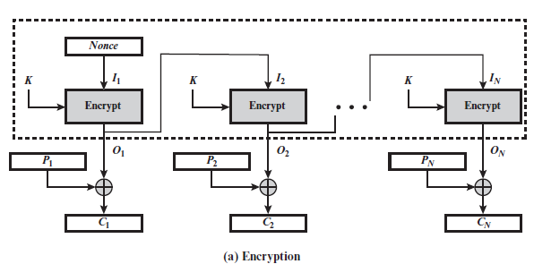
Output Feedback Mode

Slide 13
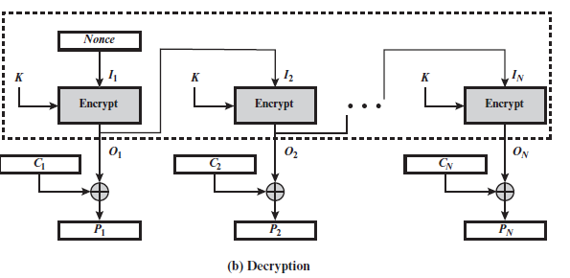
Output Feedback Mode

Slide 14
Data Encryption Standard (DES)
Until the introduction of the Advanced Encryption Standard (AES) in 2001, the Data Encryption Standard (DES) was the most widely used encryption scheme.
DES was issued in 1977 by the National Bureau of Standards, now the National Institute of Standards and Technology (NIST), as Federal Information Processing Standard 46 (FIPS PUB 46). The algorithm itself is referred to as the Data Encryption Algorithm (DEA). For DEA, data are encrypted in 64-bit blocks using a 64-bit key. The algorithm transforms 64-bit input in a series of steps into a 64-bit output. To do the encryption, DES uses "keys" where are also apparently 16 hexadecimal numbers long, or apparently 64 bits long. However, every 8th key bit is ignored in the DES algorithm, so that the effective key size is 56 bits.
The same steps, with the same key, are used to reverse the encryption.

Slide 15
Data Encryption Standard (DES)
Block Size = 64 bit Plain Text
No of Rounds = 16 rounds
Key Size = 64 bit
No of subkeys =16 subkeys
Subkey size= 48 bit subkey
Cipher Text-=64 bit cipher text

Slide 16
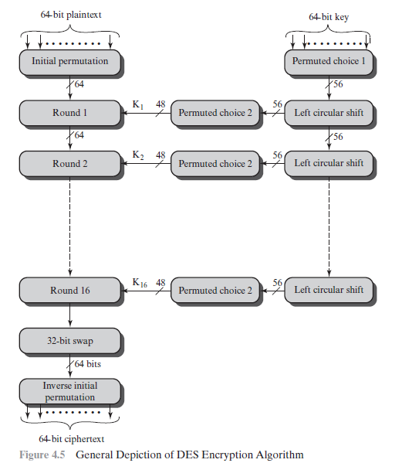
DES Encryption

Slide 17
Initial Permutation IP
first step of the data computation
IP reorders the input data bits
even bits to LH half, odd bits to RH half
quite regular in structure (easy in h/w)
no cryptographic value
example:
IP(675a6967 5e5a6b5a) = (ffb2194d 004df6fb)

Slide 18
Initial & Final permutation
Table 6.1 Initial and final permutation tables

Slide 19
Permuted choice 1
Permuted choice1
Number of bits shifts

Slide 20
Permuted Choice2
14 17 11 24 1 5 3 28 15 6 21 10
23 19 12 4 26 8 16 7 27 20 13 2
41 52 31 37 47 55 30 40 51 45 33 48
44 49 39 56 34 53 46 42 50 36 29 32
Permuted choice 2

Slide 21
DES Round Structure
uses two 32-bit L & R halves
as for any Feistel cipher can describe as:
L_{i} = R_{i–1}
R_{i} = L_{i–1}  F(R_{i–1}, K_{i})
F takes 32-bit R half and 48-bit subkey:
expands R to 48-bits using perm E
adds to subkey using XOR
passes through 8 S-boxes to get 32-bit result
finally permutes using 32-bit perm P

Slide 22
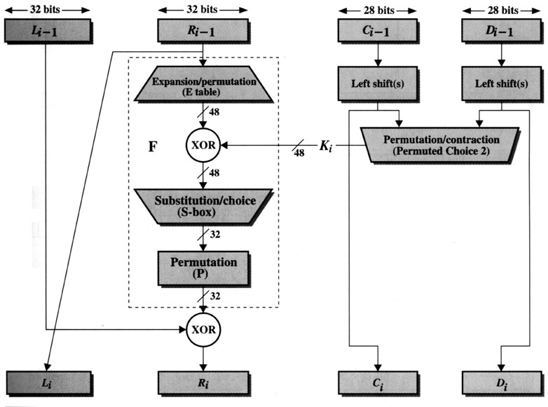
Encryption (Round)
(Key Generation)
[1]

Slide 23
Expansion P-Box
Expansion P-box table

Slide 24
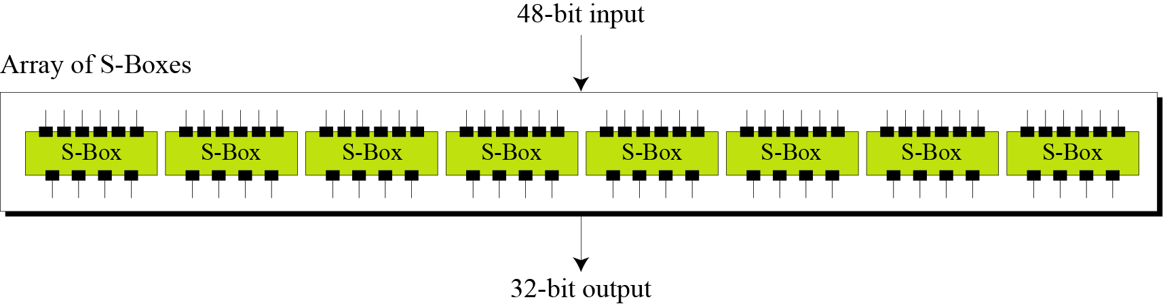
S- Box
The S-boxes do the real mixing (confusion). DES uses 8 S-boxes, each with a 6-bit input and a 4-bit output.
Figure of S-boxes

Slide 25
S-box
S-box1

Slide 26
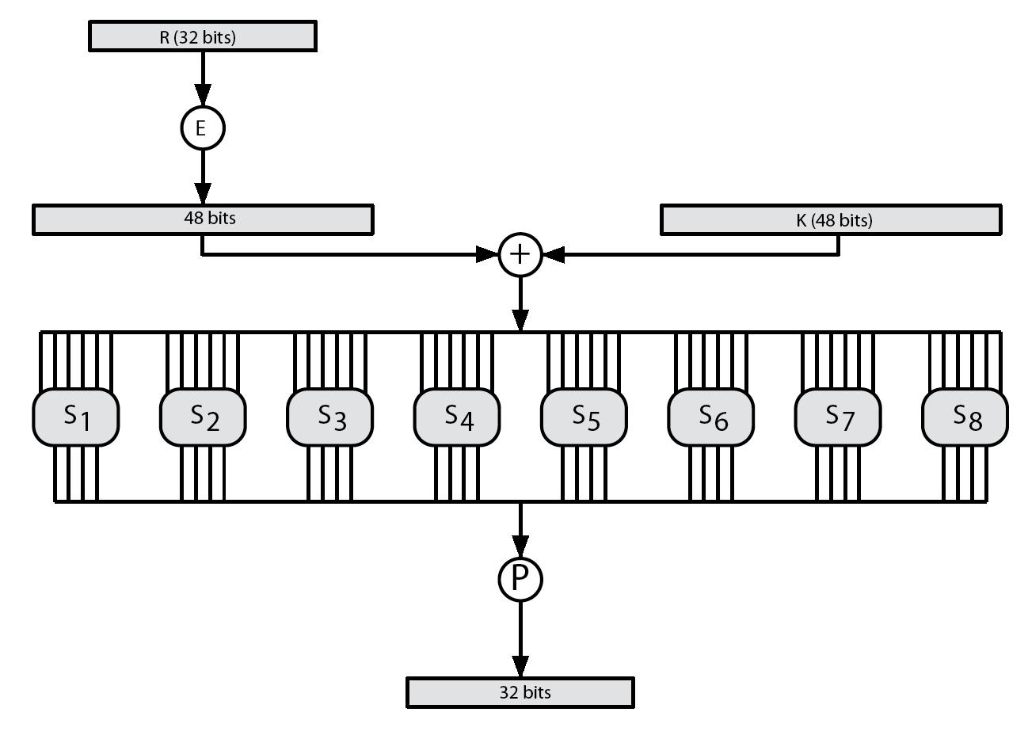
DES Round Structure

Slide 27
Permutation table
permutation table

Slide 28
AES Alogorithm
designed by Rijmen-Daemen in Belgium
has 128/192/256 bit keys, 128 bit data
an iterative rather than Feistel cipher
processes data as block of 4 columns of 4 bytes
operates on entire data block in every round
designed to have:
resistance against known attacks
speed and code compactness on many CPUs
design simplicity

Slide 29
AES Alogorithm
Block size=128 bit plaintext(4 words/16 bytes)
No. of rounds= 10 rounds.
Keysize=128 bits(4 words/16 bytes) : Size of 1 word= 32 bits.
No.of subkeys= 44 subkeys.
Each subkeysize=32 bit/ 1 word/ 4 bytes.
Ecah round = 4 subkeys(128 bits/4 wortds/ 16 Bytes)
Preround calculation= 4 subkeys(subkeys(128 bits/4 wortds/ 16 Bytes)
Ciphertext=128 bits.

Slide 30
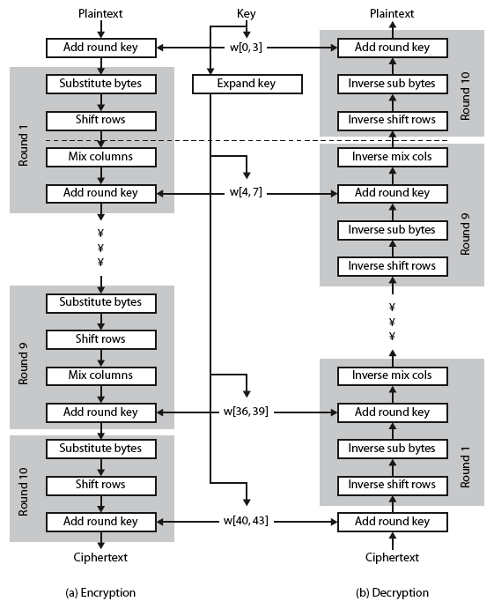
AES structure

Slide 31
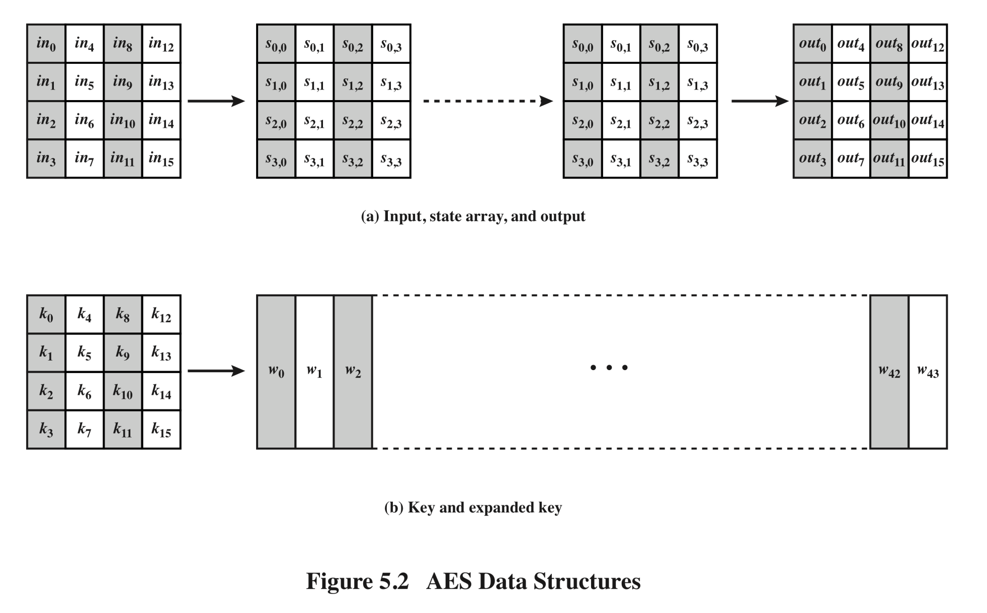
AES Data Structures

Slide 32
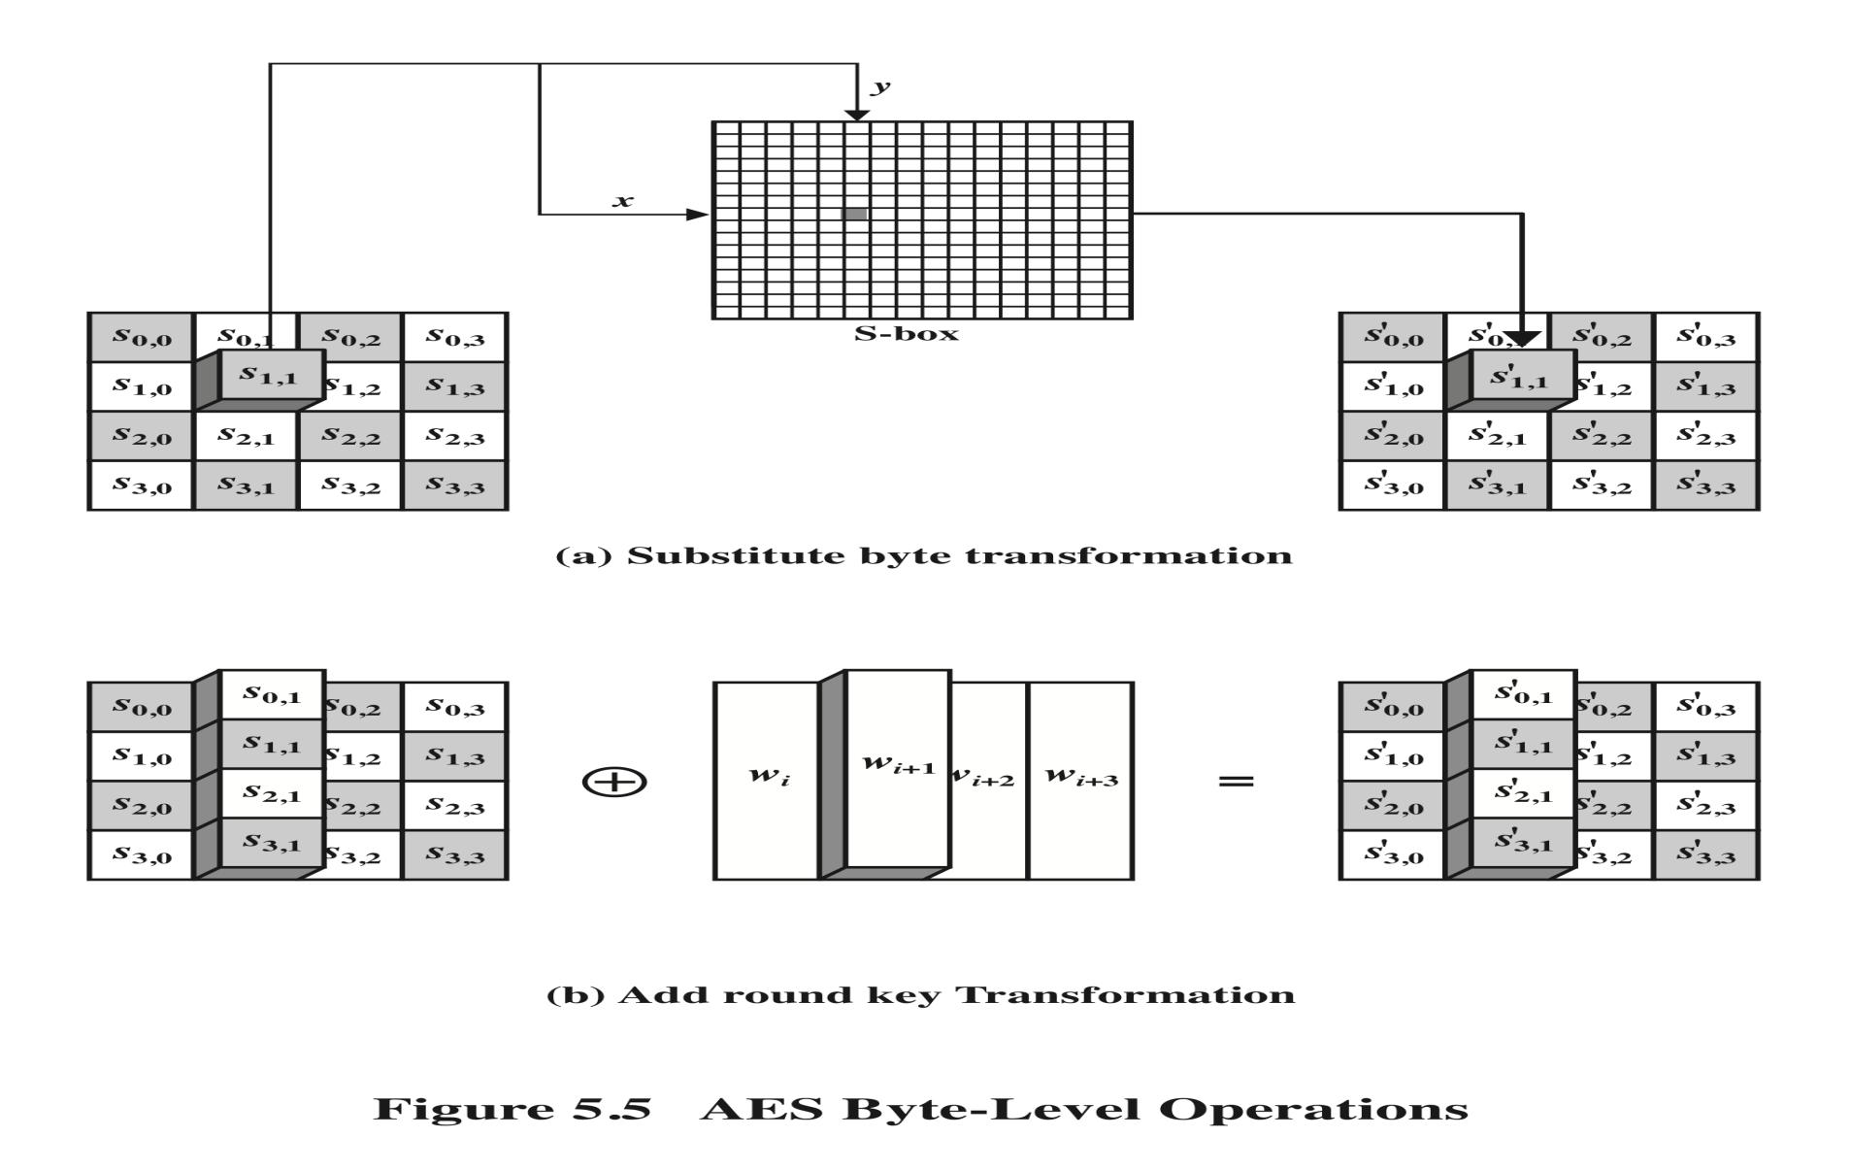
Substitute Bytes

Slide 33
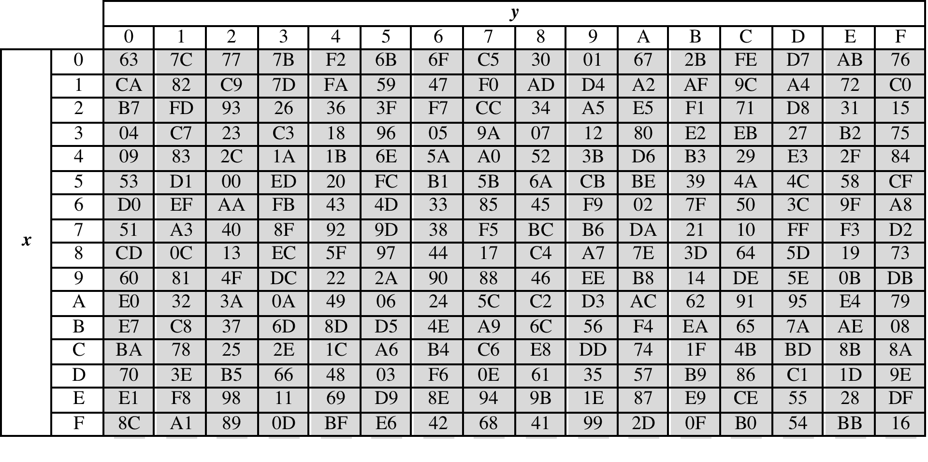
S-box

Slide 34
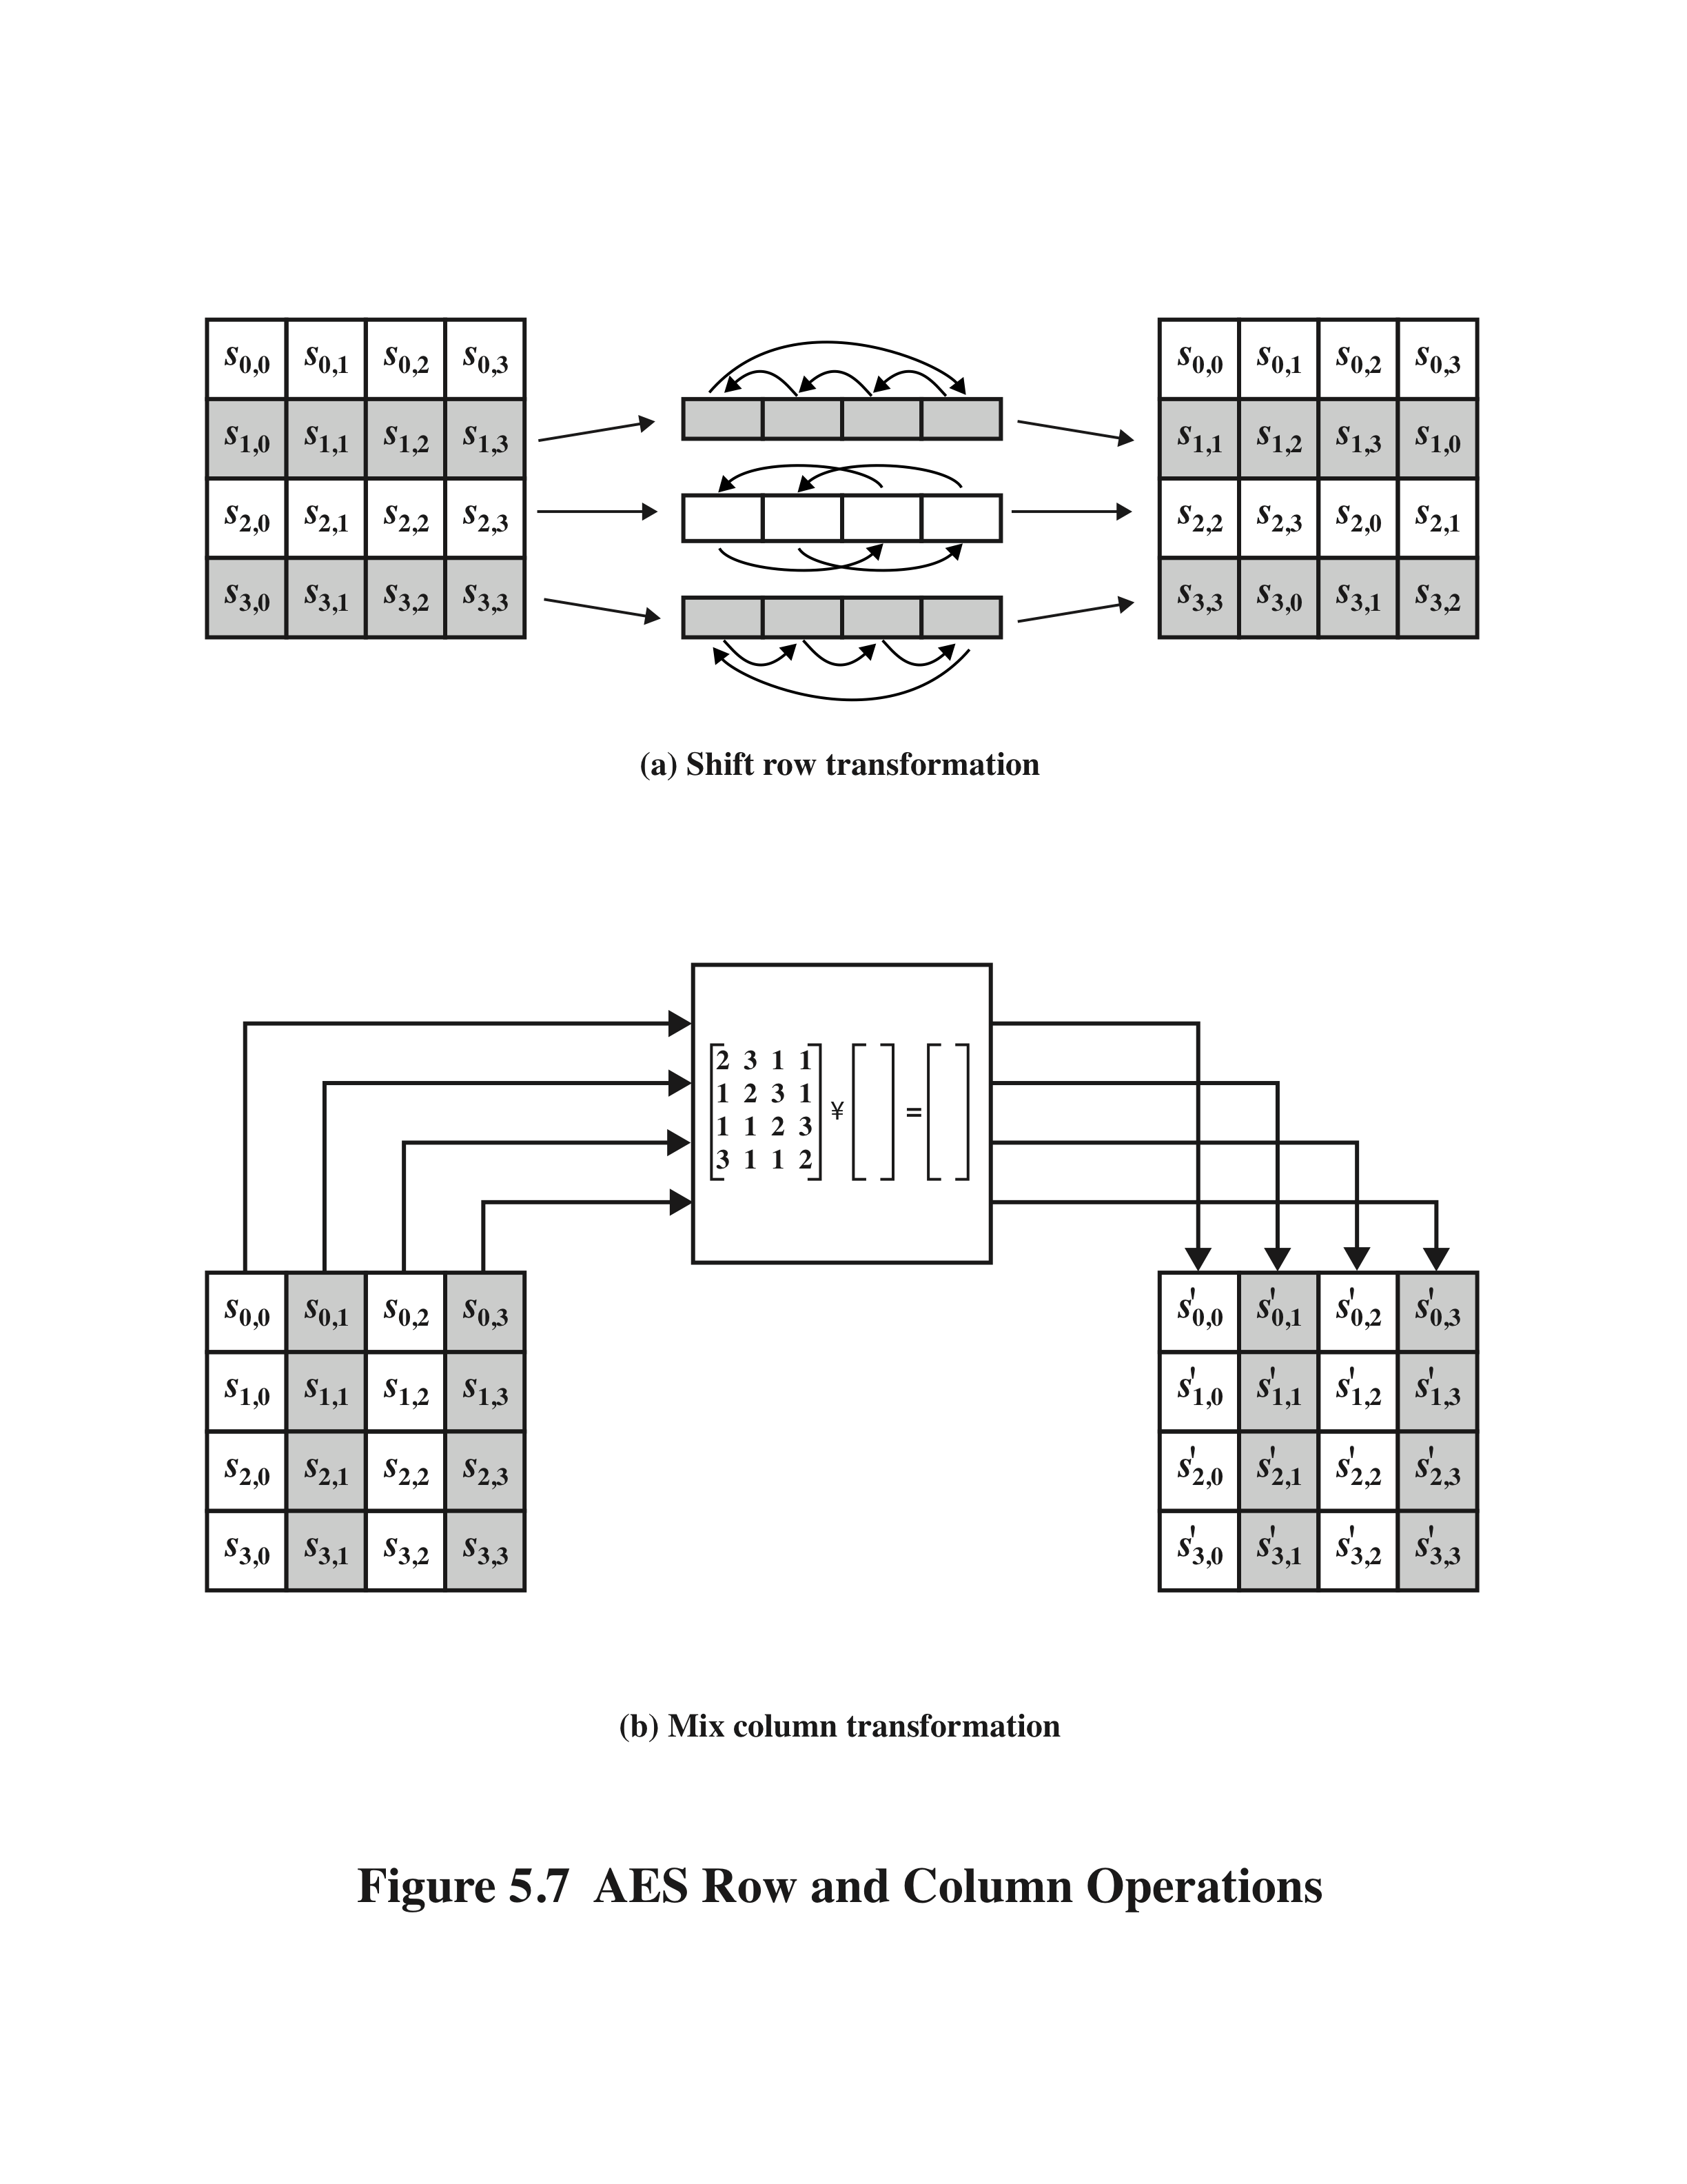
Shift Row Transformation

Slide 35

MixColumn Transformation

Slide 36
RSA Algorithm(Asymmetric Key Encryption Algorithm)
Steps
Consider two large prime numbers p,q
Calculate n = p* q ( n is product of two prime numbers).
φ(n) = (p-1) * (q-1). [ φ(n) is known as Euler's totient function , which counts the positive integers up to a given integer n that are relatively prime to ‘n’ ].
Select ‘e’( ‘e’ is public key used in encryption side) such that gcd(e, φ(n) ) =1. ( that means ‘e’ should be relatively prime or coprime to φ(n) )

Slide 37
RSA Algorithm(Asymmetric Key Encryption Algorithm)
Select ‘d’ such that d*e mod φ(n)=1. (‘d’ is the private key, which is used in the decryption side).
Now the public key is { e,n}
Private key is {d,n}
Encryption
Consider plain text message ‘M’ whgich should be less than ‘n’.( M<n)
c =M^e mod n
Decryption
M=c^d mod n

Slide 38
RSA Algorithm(Asymmetric Key Encryption Algorithm)
Example:
P=3,q=5.
n = p*q =15.
φ(n) = (p-1) * (q-1) = 2 *4 =8
φ(n)=8.
Select ‘e’ such that gcd(e, φ(n))=1. Here we can select e=3. According to RSA algorithm, gcd(e, φ(n)) must be equal to 1. Here 3 satisfies the condition.
Select ‘d’ such that d*e mod φ(n)=1. Here we can select d=3 . i.e 3* 3 mod 8=1.

Slide 39
RSA Algorithm(Asymmetric Key Encryption Algorithm)
public key={e,n}={3,15}.
private key = { 3,15}
Select plain text M. Here M=4 . M<n. i.e = 4<15
Ciphertext c=M^e mod n
=4^3 mod 15
=64 mod 15 =4
so c=4
Decryption
M=c^d mod n
= 4^3 mod 15
M=4

Slide 40
RSA Algorithm(Asymmetric Key Encryption Algorithm
Example-2:
Select primes p=11, q=3.
n = pq = 11*3 = 33.
φ(n) = (p-1) * (q-1) = 10 * 2 = 20
Choose ‘e’ = 3, which satisfies the condition gcd(e, φ(n))=1.
Compute d such that d*e mod φ(n)=1
‘d’ = 7
Public key = ( e,n) = (3, 33) Private key = (d,n) = (7,33).

Slide 41
Ciphertext c = M^e mod n M=7 i.e 7^3 mod 33 = 343 mod 33 = 13. Hence the ciphertext c = 13.
M = c^d mod n = 13^7 mod 33 = 7.
Note that we don't have to calculate the full value of 13 to the power 7 here. We can make use of the fact that
a = bc mod n = (b mod n). ( c mod n) mod n.
so we can break down a potentially large number into its components and combine the results of easier, smaller calculations to calculate the final value.
One way of calculating M is as follows:-
Note that any number can be expressed as a sum of powers of 2. In particular 7 = 4 + 2 + 1.
So first compute values of 13^2 ,13^4, 13^8,… by repeatedly squaring successive values modulo 33.

Slide 42
13^1 mod 33=13
13^2 = 169 i.e 169 mod 33 = 4.( 13^2 mod 33=4)
13^4 mod 33 = 4 * 4= 16
13^8 mod 33 = 16 * 16 =256 mod 33 = 25 etc…
Then, since 7 = 4 + 2 + 1, we have M = 13^7 = 13^ (4+2+1) = 13^4 . 13^2 . 13^1=16 * 4 *13 = 832 mod 33= 7.

Slide 43
GCD of two numbers
gcd(a,b) = gcd(b, a mod b) → [ a mod b is the remainder when a is divided by b]
Gcd(a,0) = a.
Example1:
Find gcd(3,8)
solution-:-
Here take a=3, b=8.
gcd(a,b) = gcd(b, a mod b)
gcd(3,8)=gcd(8 ,3 mod 8) =gcd(8,3) → since 3 mod 8 = 3.

Slide 44
GCD of two numbers
gcd(8,3) = gcd(3, 8mod 3)= gcd(3,2) → since 8 mod 3 = 2.
gcd(3,2) = gcd(2, 3 mod 2) = gcd(2,1) → since 3 mod 2 =1
gcd(2,1) = gcd(1, 2mod 1) = gcd(1,0) → 2 mod 1=0
gcd(1,0)=1 → since gcd(a,0) = a
so the gcd(3,8)=1.
Note: gcd of two numbers are 1 ,then those numbers are relatively prime.

Slide 45
GCD of two numbers
gcd(a,b) = gcd(b, a mod b) → [ a mod b is the remainder when a is divided by b]
Gcd(a,0) = a.
Example:
Find gcd(8,5)
solution-:-
Here take a=8, b=5.
gcd(a,b) = gcd(b, a mod b)
gcd(8,5)=gcd(5, 8 mod 5) =gcd(5,3) → since 8 mod 5 = 3.

Slide 46
GCD of two numbers
gcd(5,3) = gcd(3, 5 mod 3)= gcd(3,2) → since 5 mod 3 = 2.
gcd(3,2) = gcd(2,1)
gcd(2,1) = gcd(1,0)
gcd(1,0) =1. → since gcd(a,0)=a.
gcd(8,5)= 1.

Slide 47
DIFFIE HELLMAN KEY EXCHANGE ALGORITHM
Important points
Not an encryption algorithm
Exchange secret/symmetric key between sender and receiver.
To exchange key between sender and receiver asymmetric key encryption technique is used in Diffie Hellman key exchange. i.e public key and private key using.

Slide 48
DIFFIE HELLMAN KEY EXCHANGE ALGORITHM
Steps:
Select prime number q
Select α (alpha) such that α must be primitive root of q and α < q.
Assume X_{A} (Private key of user A) . X_{A} < q
Calculate Y_{A} (public key of user A)
Y_{A =} α^X_{A} mod q.
Assume X_{B} (private key of user B). X_{B} <q
Calculate Y_{B} (public key of user B) i.e Y_{B =} α^X_{B} mod q.

Slide 49
DIFFIE HELLMAN KEY EXCHANGE ALGORITHM
{X_{A} , Y_{A} } → private key , public key of user A
{X_{B} , Y_{B} } → private key, public key of user B.
Key generation( in sender ,receiver side)
user A user B
K=(Y_{B)})^X_{A} mod q = K=(Y_{A})^X_{B} mod q

Slide 50
DIFFIE HELLMAN KEY EXCHANGE ALGORITHM (Example)
q=11
Select α , which is a primitive root of q.
α is said to be the primitive root of q , if α^1 mod 11, α^2 mod 11, α^3 mod 11……… α^10 mod 11 gives the result = {1,2,3,4………10}.

Slide 51
DIFFIE HELLMAN KEY EXCHANGE ALGORITHM (Example) How to find primitive root of q ?
power → 1 2 3 4 5 6 7 8 9 10 (mod 11)
1 1 1 1 1 1 1 1 1 1 1
2 2 4 8 5 10 9 7 3 6 1
3 3 9 5 4 …………………
4
5
6
7
8
9
10

Slide 52
DIFFIE HELLMAN KEY EXCHANGE ALGORITHM (Example)
Here α=2.
select X_{A} , which is less than q. Here X_{A} = 8 (private key)
calculate Y_{A} = α^X_{A} mod q. = 2^8 mod 11 = 3
i.e Y_{A} = 3.
Select X_{B,} which is less than q. Here X_{B} = 4 (private key)
calculate Y_{B} = = α^X_{B} mod q = 2^4 mod 11
Y_{B} = 5
User A ={X_{A} =8, Y_{A=} 3}
User B= {X_{B} =4, Y_{B=} 5}

Slide 53
DIFFIE HELLMAN KEY EXCHANGE ALGORITHM (Example)
Sender (User A) Receiver(User B)
K=(Y_{B)})^X_{A} mod q K=(Y_{A})^X_{B} mod q
=(5)^8 mod 11 = (3)^4 mod 11
=390625 mod 11 = 81 mod 11
= 4 = 4
Note that we don't have to calculate the full value of 5 to the power 8 here. We can make use of the fact that
a = bc mod n = ((b mod n). ( c mod n) )mod n.
5^8 =(5^2 . 5^2 .5^4 mod 11) mod 11

Slide 54
5^2 mod 11= 25 mod 11 = 3
(5^4 mod 11= 625 mod 11= 9
5^8 =(5^2 . 5^2 .5^4 mod 11) mod 11
So (3. 3.9) mod 11= 81 mod 11 = 4

